Slide 1

COIMBATORE INSTITUTE OF TECHNOLOGY
_______________________________________________
DEPARTMENT OF COMPUTING
MSc.Software Systems
1ST Year – 2ND Semester
OBJECT ORIENTED PROGRAMMING

Slide 2
LIBRARY MANAGEMENT SYSTEM
2031035 – RITHIK SUTHAN S
2031015 – GOKULA KRISHNAN S
2031052 – THIYANESAN K
2031054 – VIJAY NARENDARAN V
2031041 – SAUGHANTHIKA K E
2031024 – LAKSHANA S

Slide 3
PROBLEM DEFINITION
MAIN MOTTO OF OUR PROJECT IS TO IMPLEMENT THE LIBRARY MANAGEMENT SYSTEM , THAT WE HAVE CREATED AN USER- FRIENDLY ENVIRONMENT AS CODING !!!!

Slide 4

Concepts Used:
CLASSES.
OBJECTS.
COMMAND LINE ARGUMENTS.
INHERITANCE.
BINARY FILES.

Slide 5
WHY WE USE THOSE !?
COMMAND LINE ARGUMENTS | BINARY FILES | INHERITANCE
TO CREATE DAT FILES,WE USE COMMAND LINE ARGUMENTS | TO STORE THE DATA THAT HAS BEEN ENTERED | TO USE MULTIPLE CLASS WITHIN A SINGLE , WE USED INHERITANCE

Slide 6
What We Have Done !?
FIRSTLY WE CREATED FILES USING COMMAND LINE ARGUMENTS.
THEN WE WILL ADD OR DELETE SOME DETAILS ABOUT THE BOOKS WHICH WERE IN THE LIBRARY.
THEN WE WILL DISPLAY THE DETAILS.
AFTER THIS WE CAN MODIFY THE DETAILS , THAT WE HAVE ENTERED.
THEN WE CAN SEARCH THE BOOK WE NEED.
WE CAN ALSO DO ISSUE AND RETURN THE BOOK.

Slide 7
WE HAVING TWO MAIN MODULES:
FIRSTLY , The Admin That Means Staff Section Comes, The Staff Will Create , Add , Search & Delete , Modify And Display The Books Which Are In The Library.
Here The Student Section Comes , Students Can Return The Book That They Had.

Slide 8
HOW WE START !?
We Start By A Login Page.
By Loging In We Can Give The Staff That Means Admin Or Student To Choose Any One Of The Choice That We Have Specified Early.
As Per Their Choice , We Can Get Through The Flow Of The Program.

Slide 9
CREATE A FILE:
To Create A File , We Have Used Command Line Arguments.
Using That We Have Created 21 DAT Files .
That Is , We Have Five Types Of Sections In Library (i.e.), Articles , References , Reports & Docs , Fantasy , Encyclopedia And Journals ….!
Here To We Have Some More Sub Divisions In Each Sections.

Slide 10
ADD BOOK:
To Add Book To Each Sections , We Created Separate Functions.
We Need To Enter Or Give The Book Reference ID , Book Name , Date Of Publication And Author Name.
As By Doing This The Book Will Be Added In The Specified Sections.

Slide 11
DISPLAY:
To Display The Details Of The Book , We Created Separate Functions.
To Display The Details , Choose The Specified Section He / She Need.
The Entire Books Of That Specified Section Will Be Displayed.

Slide 12
MODIFY:
Here We Have Gave A Choice To Modify The Details Of The Specified Book That We Have Entered.
To Modify , The User Should Enter The Reference Book ID Of The Specified Book.
Then It Will Ask You To Change or Modify The Details What You Need.
If We Will Enter The Ref ID Which Is Not In The File , It Will Alert You To Enter The Available One.

Slide 13
DELETE:
To Delete Book From Each Sections , We Created Separate Functions.
We Need To Enter Or Give The Book Reference ID That Need To Be Deleted.
As By Doing This The Book Will Be Deleted In The Specified Sections.

Slide 14
ISSUE:
Firstly , It Will Accept The Name From The User.
Next It Will Ask The Issue Date.
And Finally , It Will Ask The Return Date .
Admin Will Provide The Issue Number Which Will Be Differ For Each Issues.
User Is Asked To Re-Enter The Issue Number To Register.
It Will Ask What Kind Of Book They Need & It Will Be Issued To The User.

Slide 15
RETURN:
Firstly , It Will Ask To Specify The Issue Number.
It Will Ask To Enter The Student Name.(If Entered Wrongly , It Will Ask To Re-Enter).
It Will Ask To Enter The Issue Date & The Return Date .(If Entered Wrongly , It Will Ask To Re-Enter).
If The Above Mentioned Steps Are Valid , The Return Process Will Be Executed.

Slide 16
VALIDATIONS
FOR VALIDATE OUR CODE WE USED:
cin.ignore()- To Clear Buffer
goto statements – To Enter The Correct Choice If Suppose We Enter Invalid Choice
fflush(stdin) – To Restrict The Buffer.

Slide 17
OUTPUTS

Slide 18
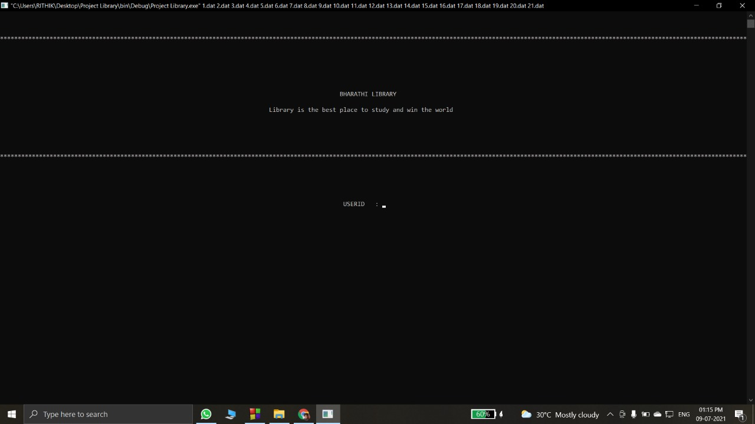

Slide 19


Slide 20
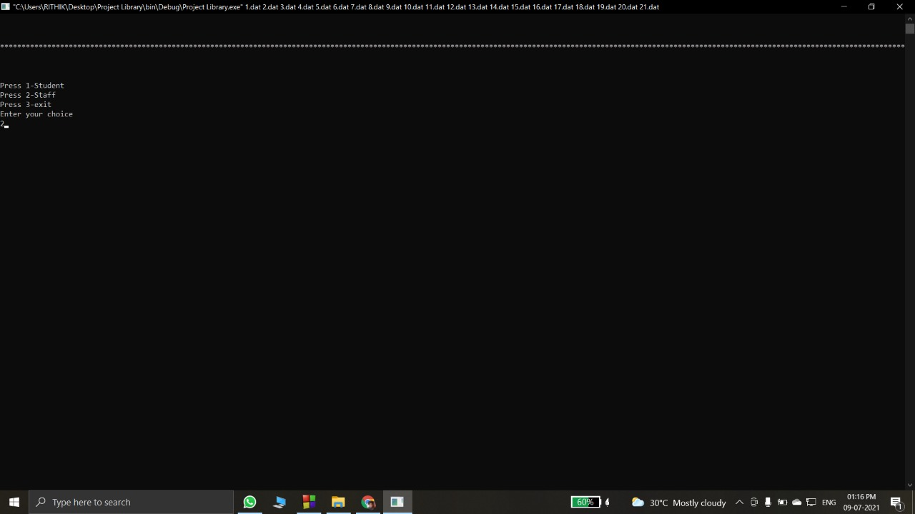

Slide 21
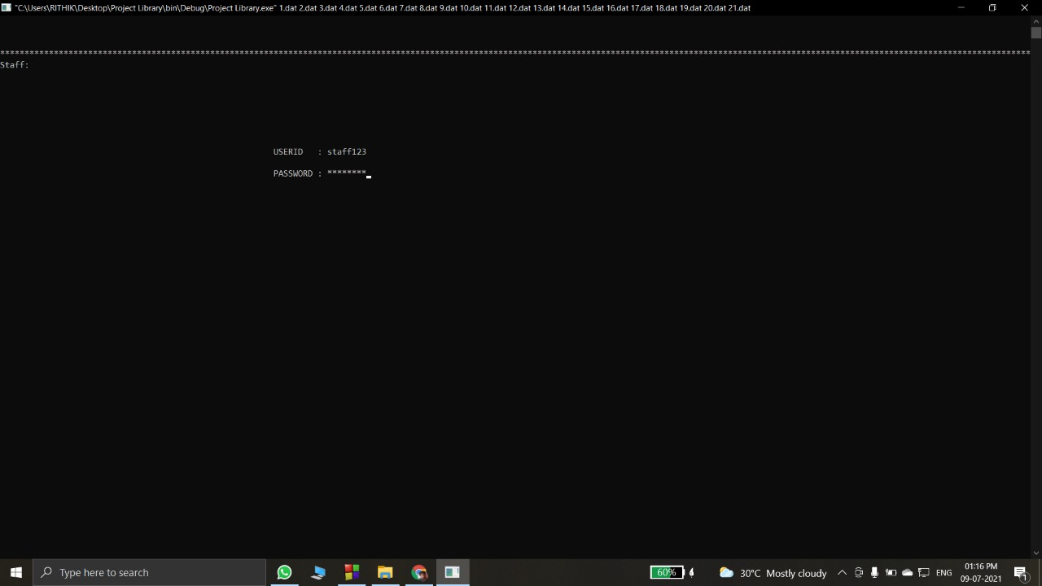

Slide 22
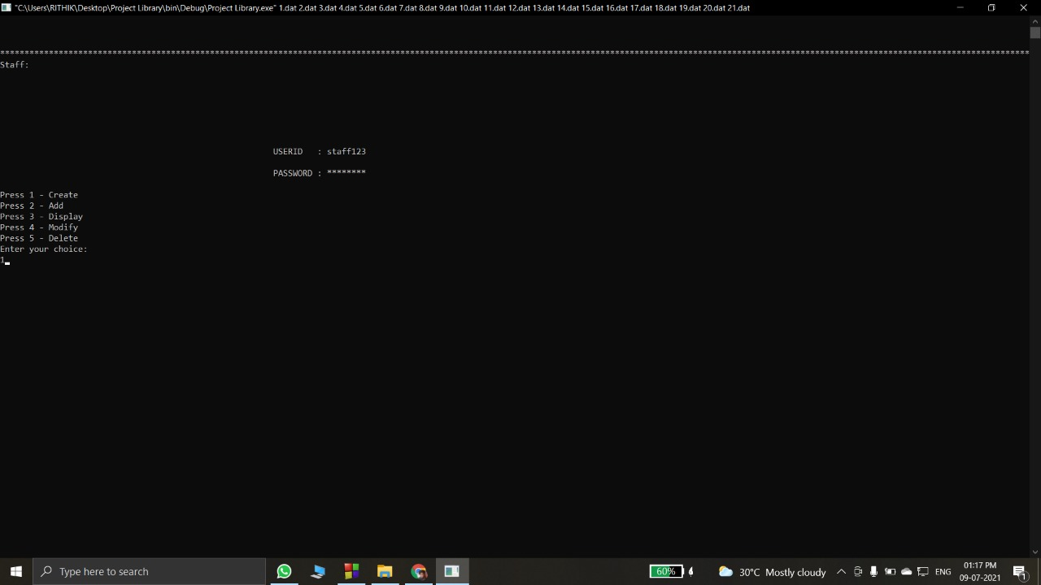

Slide 23
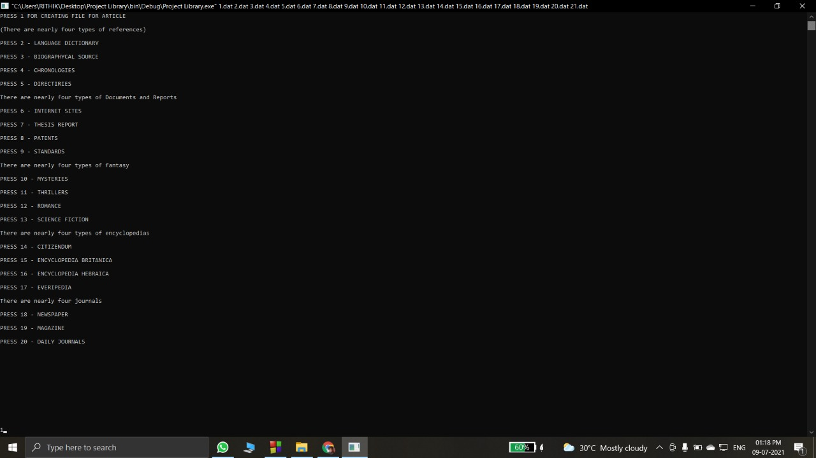

Slide 24
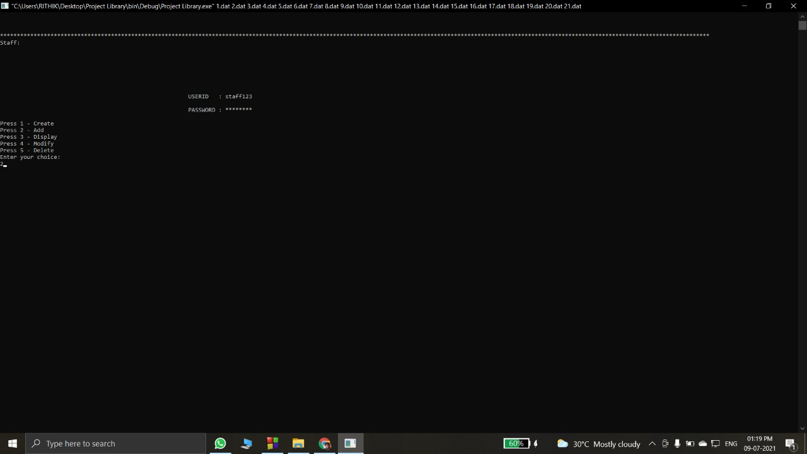

Slide 25
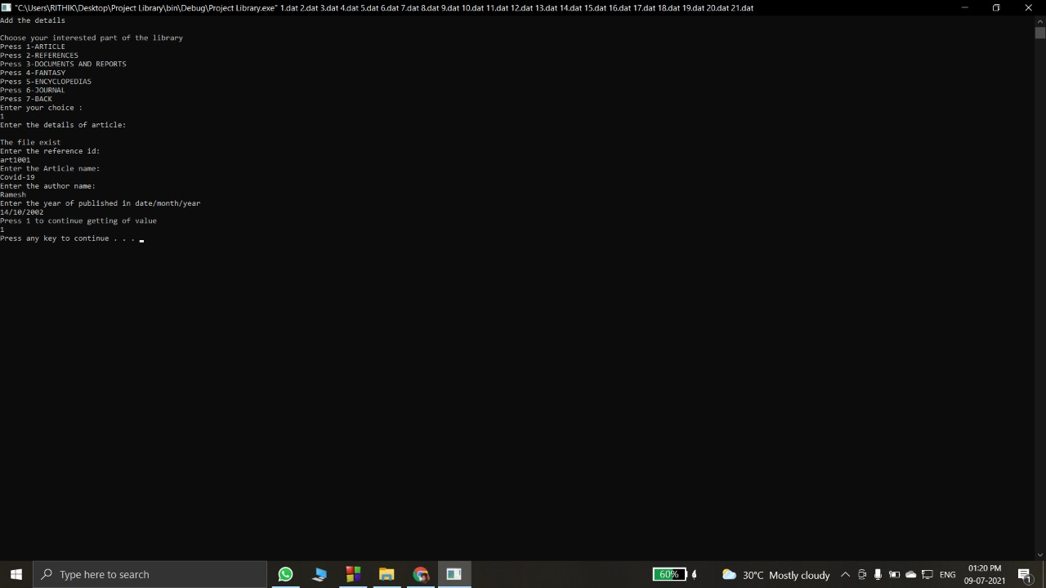

Slide 27
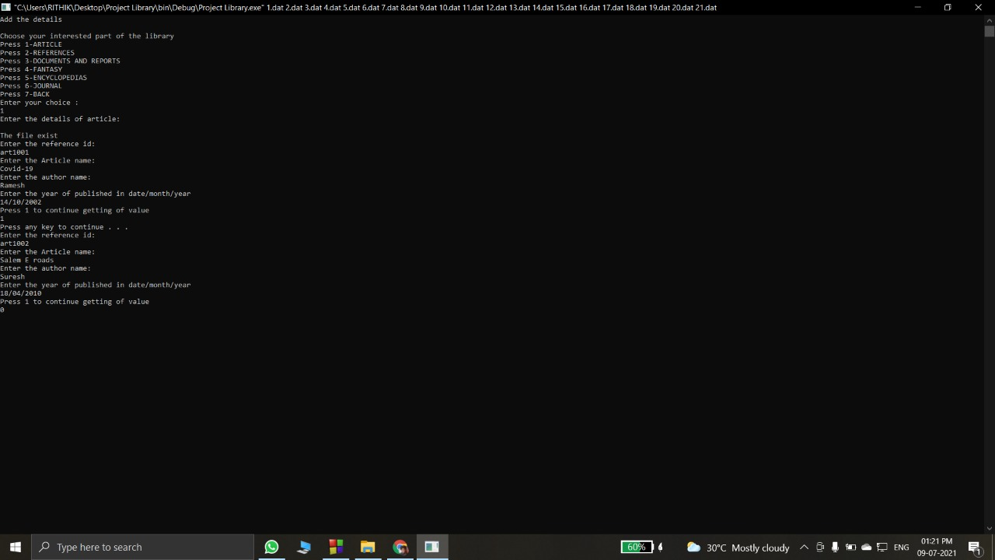

Slide 28
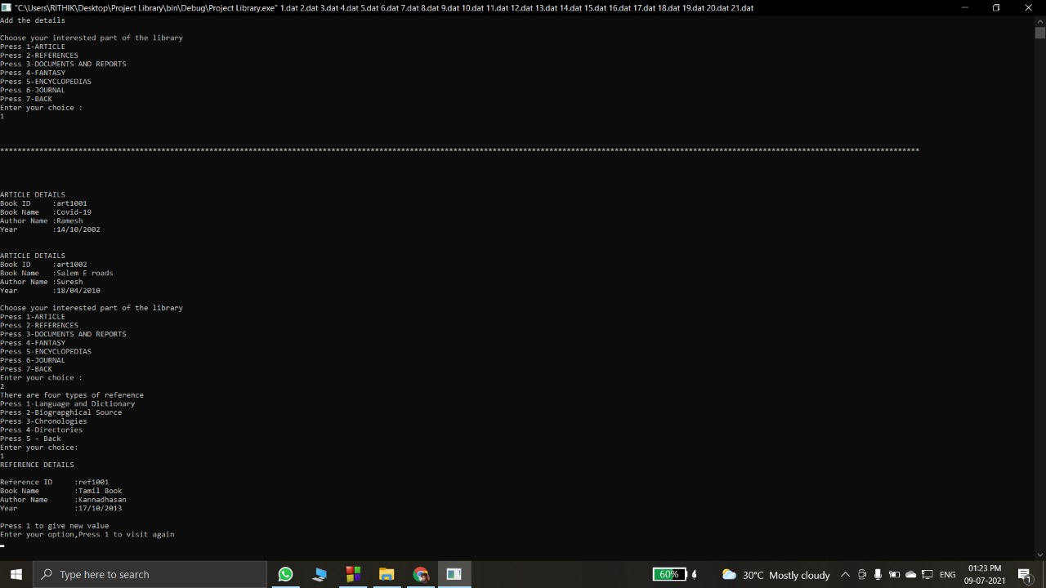

Slide 29
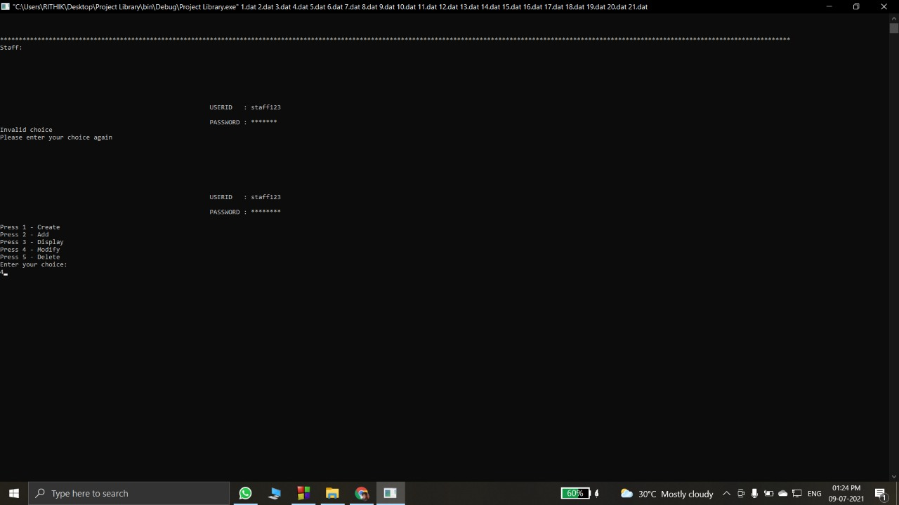

Slide 30


Slide 31
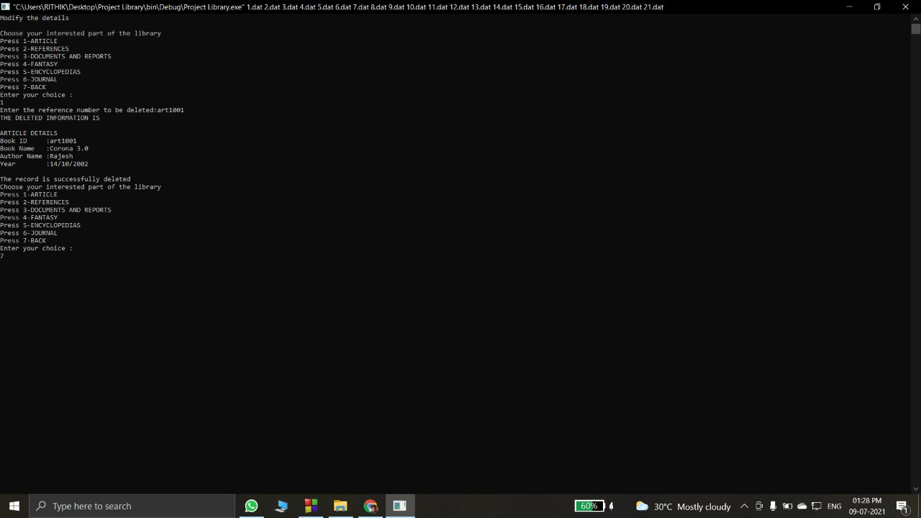

Slide 33
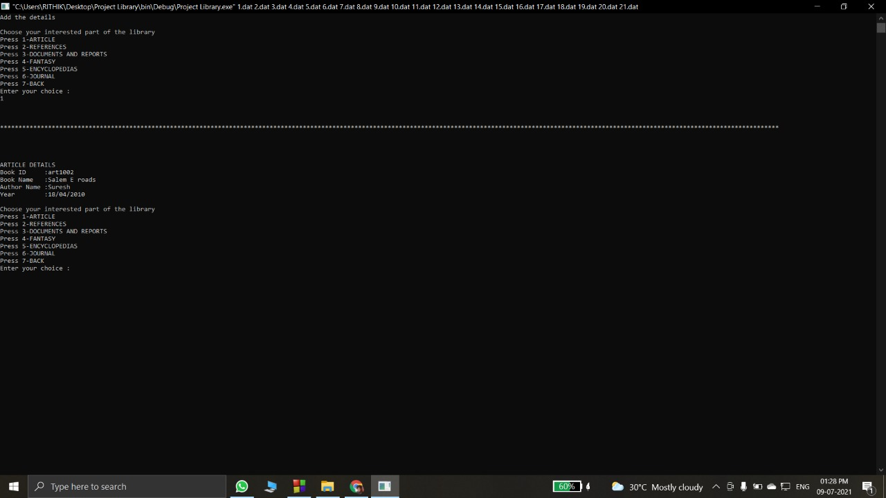

Slide 36
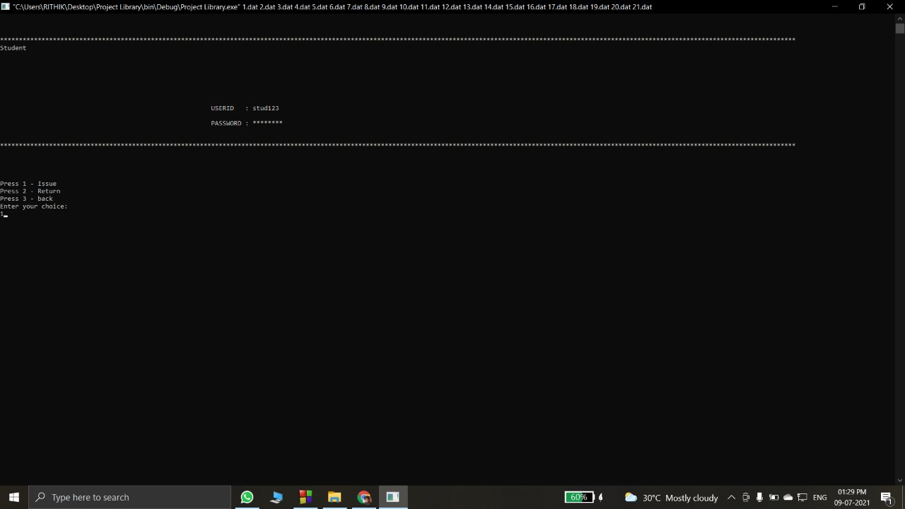

Slide 40
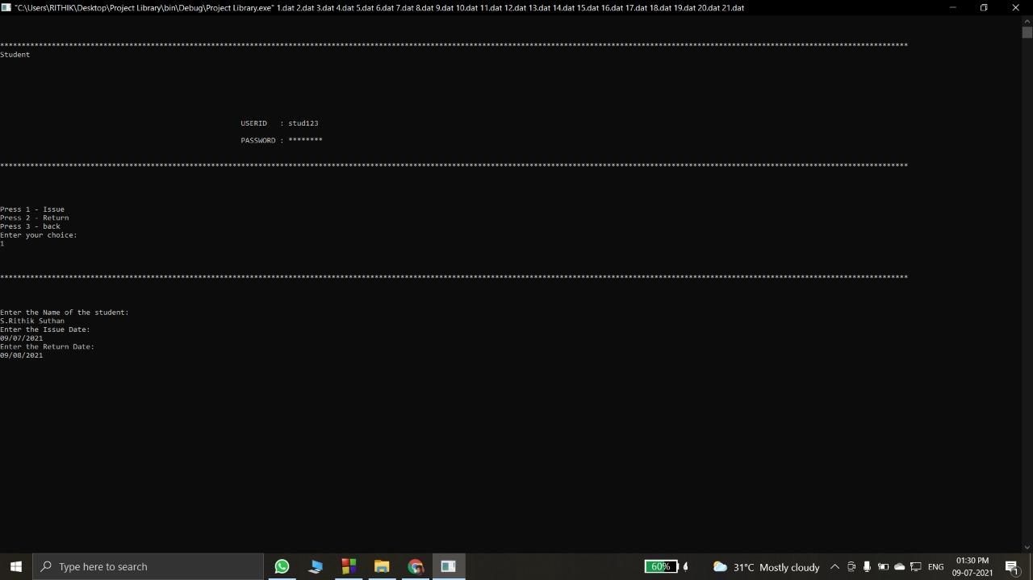

Slide 41
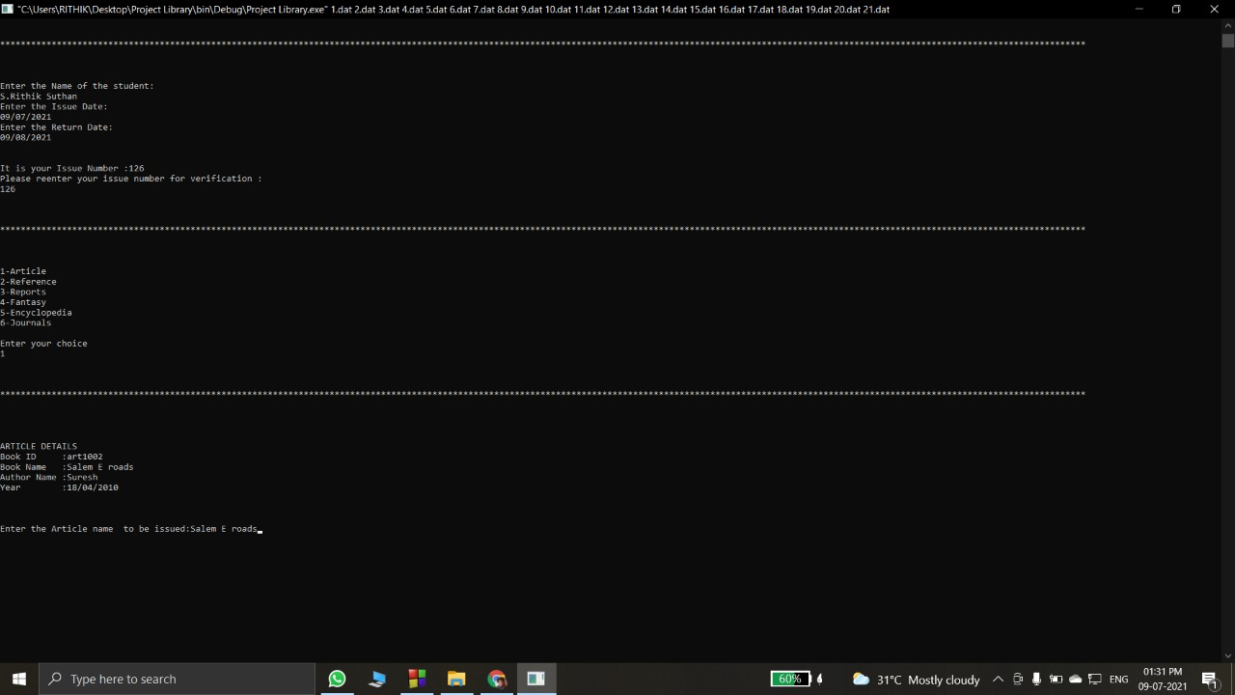

Slide 42
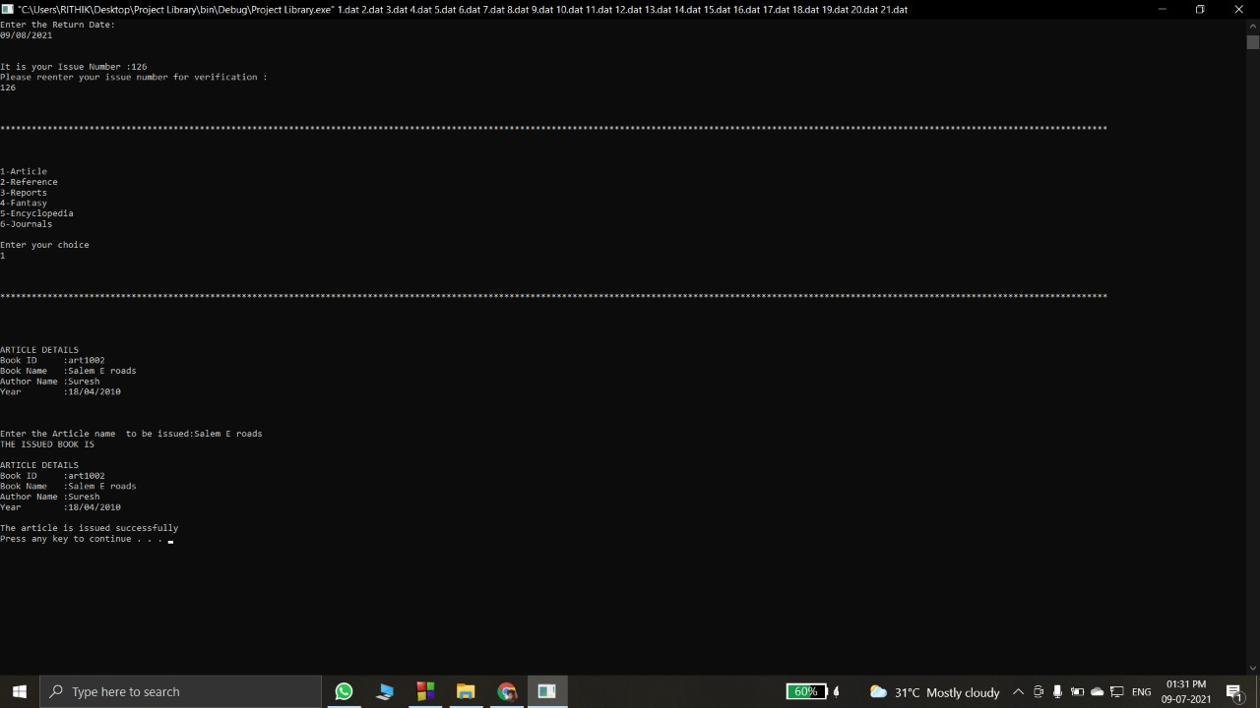

Slide 43
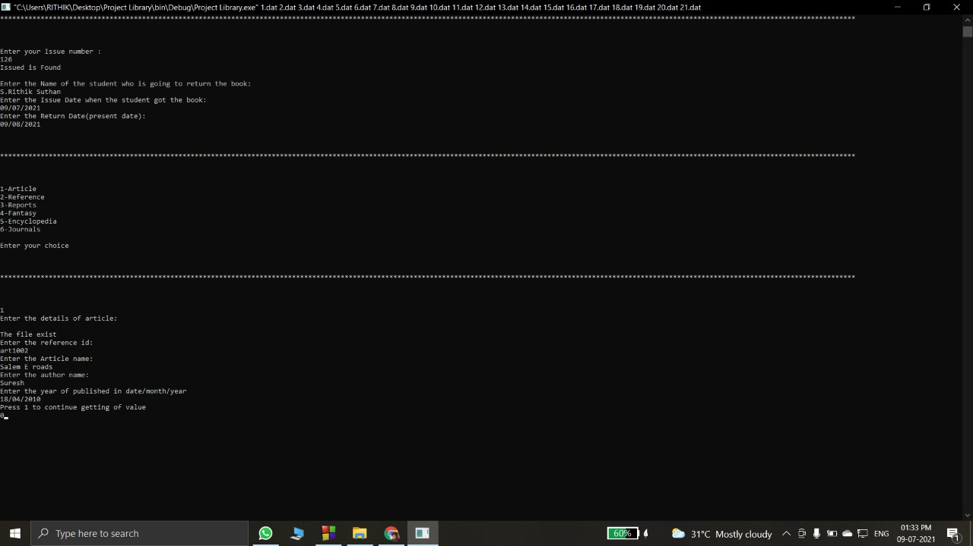

Slide 47


Slide 48
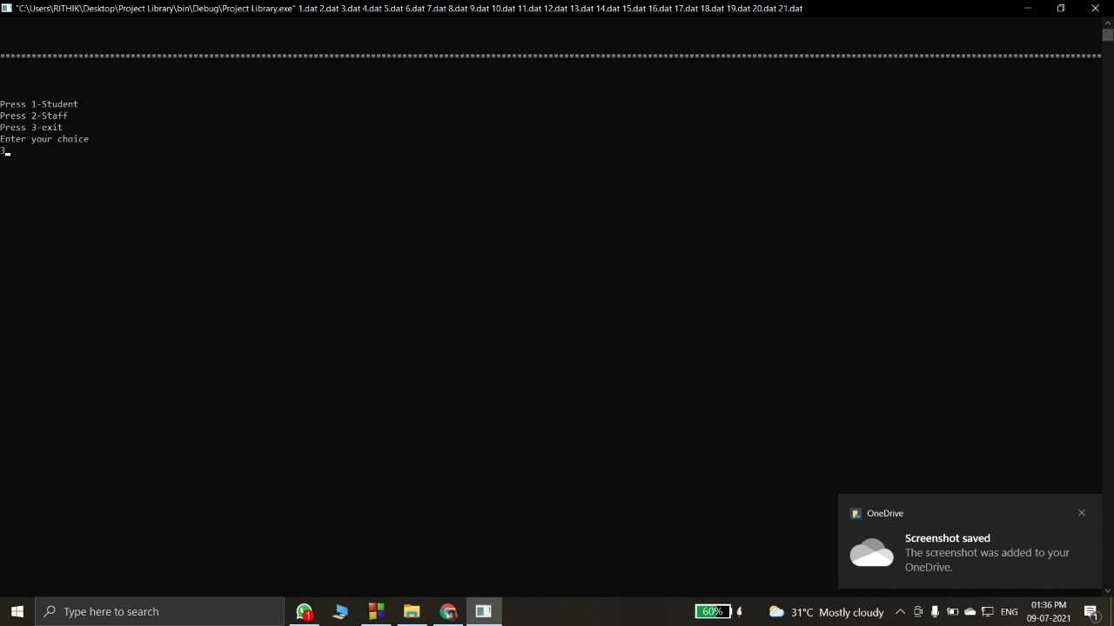

Slide 49
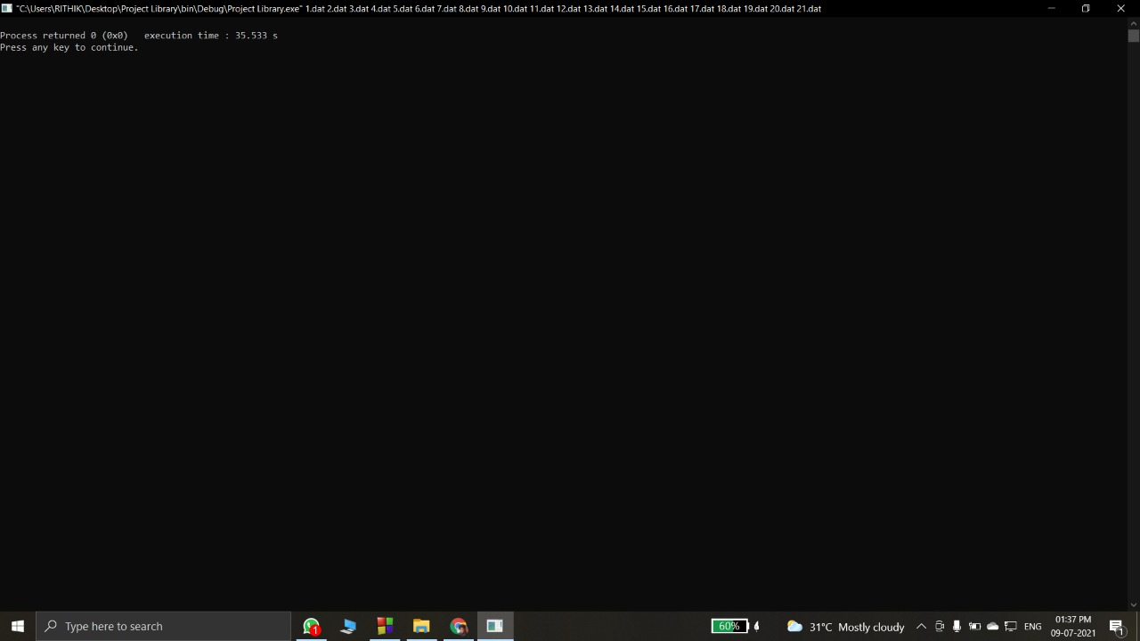

Slide 50
THANK YOU!!!!

